Slide 1
Machine Learning–Based Plant Stress Detection
Comparative Analysis of Ensemble Models with Feature Selection
Zahra Nazar Zadeh Attar, Iman Javaheri Neyestanak, Kasra Alizadeh
Prof. Maurizio Magarini • Prof. Silvia Mura
Communication in Green Infrastructure
February , 2026

Slide 2
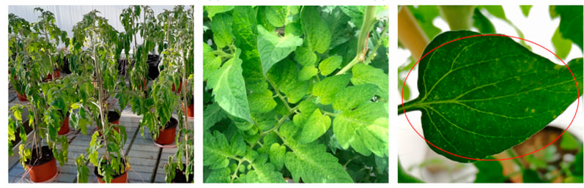
Project Overview
Machine learning approach for plant stress detection using electrophysiological signals, targeting sustainable agriculture and green infrastructure.
Non-invasive plant sensing enables reliable stress identification
Resource-efficient and environmentally friendly monitoring
Complete pipeline: preprocessing → windowing → feature extraction → classification
Ensemble methods achieve highest performance on cross-validation and test data

Slide 3
Problem Overview
Environmental stress causes major crop loss and reduced productivity
Delayed detection leads to irreversible damage and high costs
Traditional methods struggle with complex physiological signals
Early detection essential for timely intervention

Slide 4
Research Objective
Develop a robust machine learning framework for plant stress detection using electrophysiological signals
Binary classification: stressed vs non-stressed
Non-invasive signal acquisition
Support sustainable agriculture and precision farming

Slide 5
Dataset Overview
36 plants, 5 species
Three stress types
24h normal + 24h stressed
500 Hz sampling

Slide 6
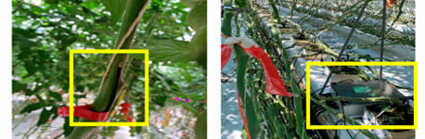
Measurement Setup
Non-invasive electrode placement on stem
High-impedance recording (MΩ range)
Multi-channel acquisition
Continuous 48h monitoring

Slide 7
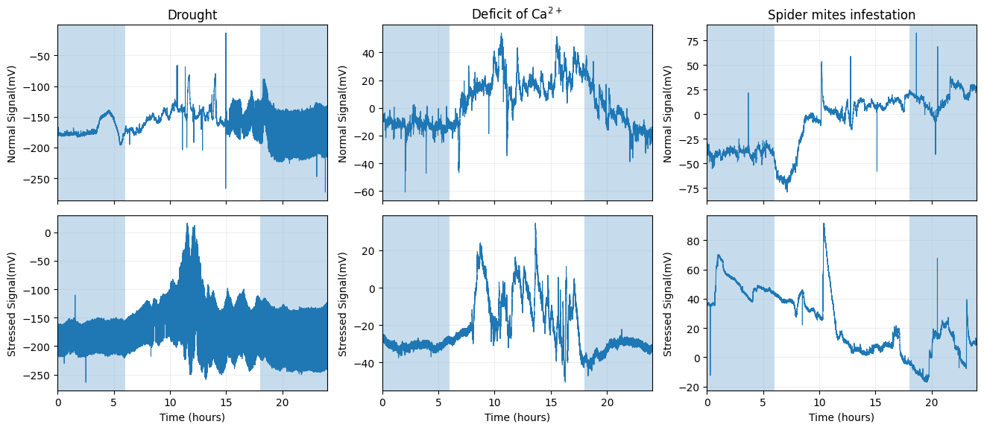
Electrophysiological Signals

Slide 8
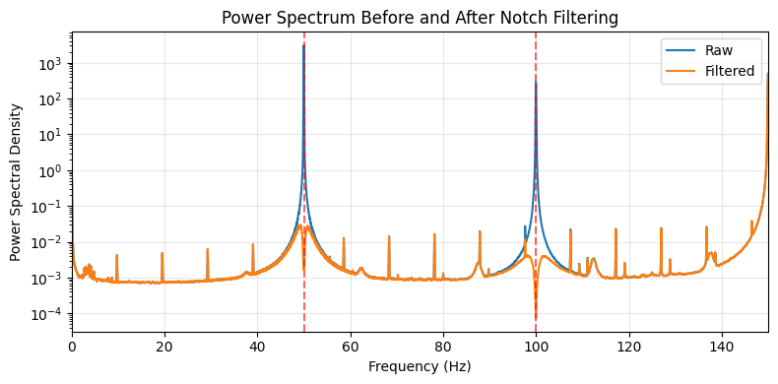
Signal Preprocessing
Notch filtering: 50 Hz and 100 Hz removal
Segment-based windowing
34 features per window
Min-max normalization

Slide 9
Feature Engineering (34 Features)
Time Domain
Statistics, Hjorth parameters, RMS, Hurst exponent
Frequency Domain
Spectral centroid, RMS, spread, noise similarity
Time-Frequency
Wavelet packet entropy, Daubechies-8 coefficients

Slide 10
Machine Learning Models
Linear
Linear SVC
Probabilistic
Gaussian NB
Neural
MLP
Ensemble
Extra Trees, Random Forest, HistGradientBoosting

Slide 11
Optimization Strategy
Consistent pipeline: normalization → feature selection → classification
RandomizedSearchCV with 3-fold stratified cross-validation
Macro F1-score as primary evaluation metric
SelectKBest with ANOVA F-test for feature selection

Slide 12
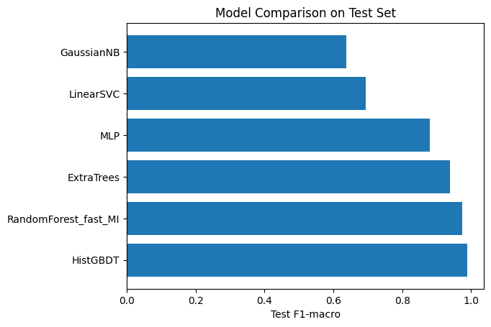
Model Performance Comparison

Slide 13
Detailed Performance Metrics
Model | Test F1 | ROC-AUC | PR-AUC
HistGBDT | 0.9881 | 0.9992 | 0.9993
Random Forest | 0.9742 | 0.9965 | 0.9969
Extra Trees | 0.9384 | 0.9855 | 0.9869
MLP | 0.8800 | 0.9511 | 0.9536

Slide 14
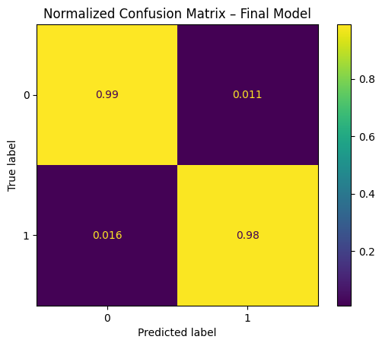
HistGradientBoosting Performance
Overall accuracy: 98.64%
Normal: Precision 0.984, Recall 0.989
Stressed: Precision 0.989, Recall 0.984
Balanced performance

Slide 15
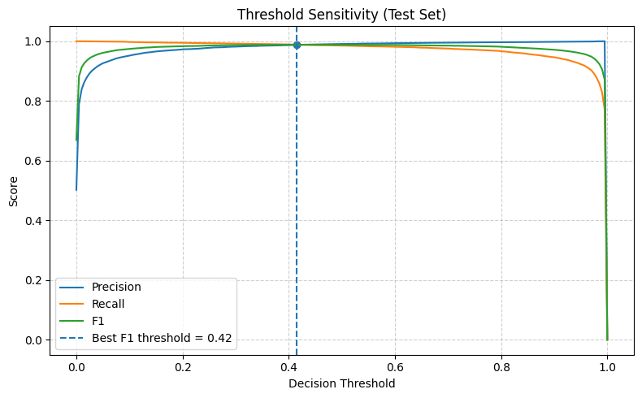
Decision Threshold Sensitivity
Precision, recall, and F1-score remain high across wide threshold range

Slide 16

Ensemble methods significantly outperform linear and probabilistic models
Feature selection critical: 50-200 features optimal
Multi-domain features capture complex plant responses
High threshold stability indicates robust predictions
Key Insights

Slide 17
Limitations
Controlled environment may limit real-world generalization
Handcrafted features may miss latent representations
Temporal correlation from windowing not explicitly modeled
Binary classification only (stress type not identified)

Slide 18
Future Directions
Cross-species domain adaptation for better generalization
End-to-end deep learning (transformers, CNNs)
Multi-class classification: stress type and severity
Real-time deployment for continuous monitoring

Slide 19
Conclusion
Complete ML pipeline for plant stress detection from electrophysiological signals
HistGradientBoosting achieves 98.81% F1-score
Demonstrates effectiveness of ML for agricultural monitoring
Supports sustainable agriculture and precision farming

Slide 20
Thank You!
Questions
Zahra Nazar Zadeh Attar • Iman Javaheri Neyestanak • Kasra Alizadeh
Communication in Green Infrastructure
Politecnico di Milano

